Slide 1
Bell Work:
Any Questions Before the Test?!

Slide 2
From Last
Review for Test:
Page 268 #4–10, 13–16, 21, 27–44,
49–52, 61–64, 70–83

Slide 3
ALGEBRA 3
Day 38

Slide 4
Things to Study for Quadratics Test
Level 2: Level 4:
Factor (4 problems) Solve a story problem Graph (2 problems) modeling quadratics Simplify with i (5 problems)
Expand on solving a quadratic to other polynomials
Level 3: Solve Quadratic (5 problems) --use any method (graphing, factoring, quadratic formula)

Slide 5
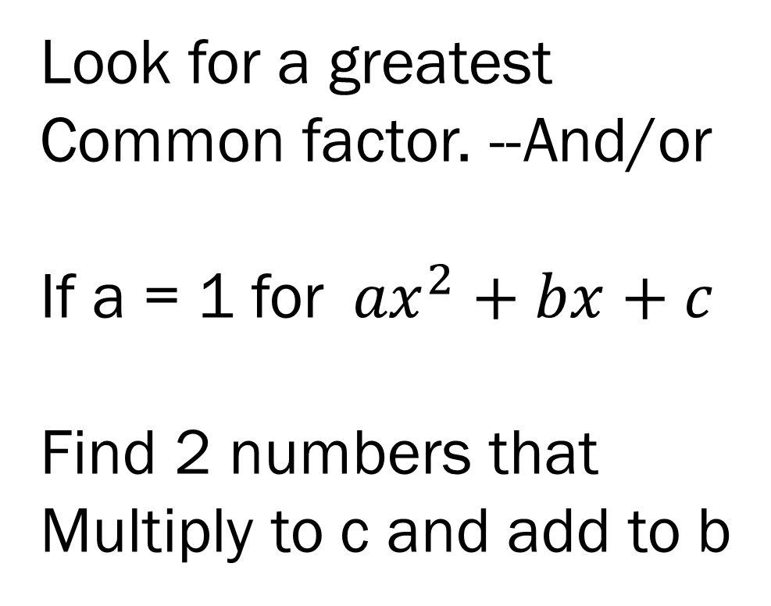
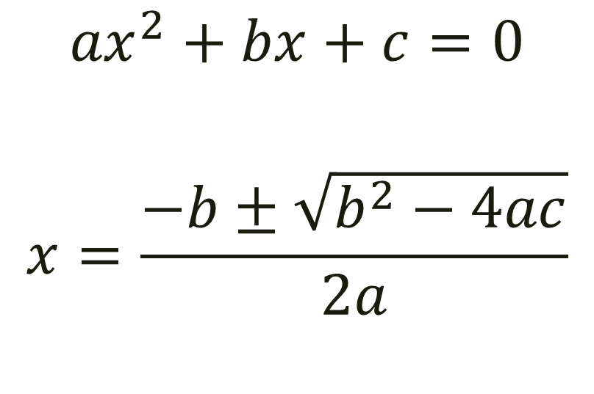
Quadratic Formula for Solving:
Simplify with Factoring:
Look for a greatest
Common factor. --And/or
If a = 1 for${ax}^{2}+bx+c$
Find 2 numbers that
Multiply to c and add to b
$${ax}^{2}+bx+c=0$$
$$x=\frac{−b±\sqrt{b^{2}−4ac}}{2a}$$

